Slide 1
Structure of Science
S. R. Kulkarni

Slide 2
Science: Phenomenology & Understanding
Phenomenology has three distinct steps
  Discovery
  Systematic study of phenomena: Search for patterns
  Inference: Physical models to explain observations (and occasionally make predictions)
Understanding
  Physics distills phenomena into essential rules & laws
  Mathematics is the natural language of physical models
    makes it possible to compute the signals
Notes:
Joke: As you know I am an observer which I means that I get to paid to observe. I have observed that in general theorists are excellent consumers of jokes. In fact, the better the theorist the more the person is a connoisseur of jokes. Even within theorists string theorists are particularly eager to hear good jokes. In fact Spenta is an excellent example of this conclusion.

Slide 3
Mathematics & Technology
Mathematics is the queen of sciences.
Discovery is largely a function of technology
Example
  Planetary Motion noticed by ancient scientists
  With the first telescope Galileo discovered moons of Jupiter
  Brahe made careful observations of planetary positions
  Kepler distilled the data into three laws of Kepler
  Newton developed the theory of Gravity (inverse square law force)
  Newton & Leibniz developed calculus
  Birth of modern Mechanics
  Gauss computed trajectories and made predictions.
Notes:
Joke: As you know I am an observer which I means that I get to paid to observe. I have observed that in general theorists are excellent consumers of jokes. In fact, the better the theorist the more the person is a connoisseur of jokes. Even within theorists string theorists are particularly eager to hear good jokes. In fact Spenta is an excellent example of this conclusion.

Slide 4
A. Physics in the 20th century

Slide 5
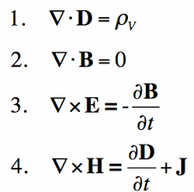
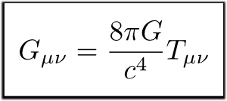
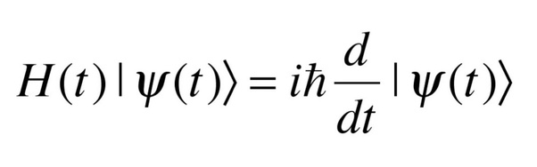
The Three Laws of Thermodynamics

Slide 6
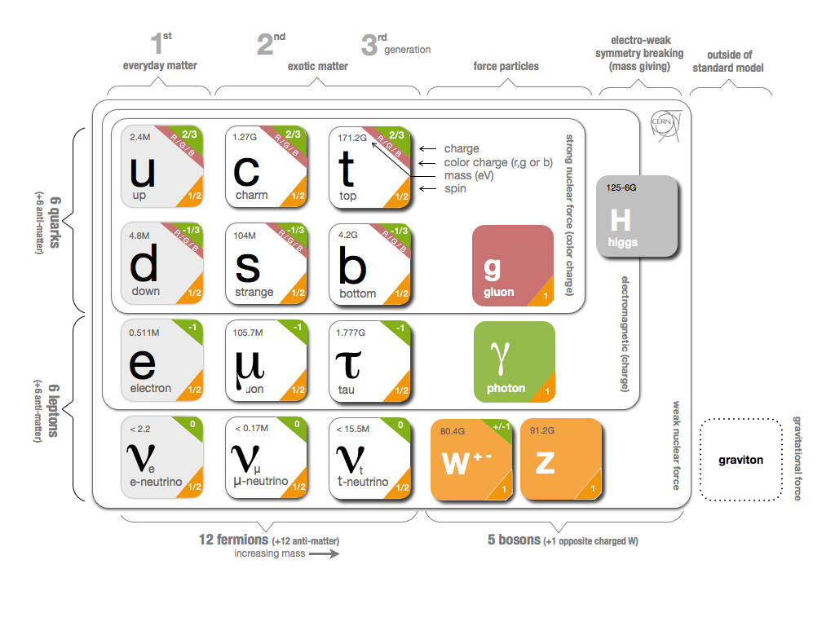

Slide 7
B. Astronomy in the 20th century

Slide 8
Modern examples of the search for patterns
The use of Ia supernovae for cosmography
  Supernovae are the routinely brightest events in the Universe
  Astronomers patiently studied the possibilities of using supernovae as standard candles
  After a lot of “phenomenological” work supernovae of type Ia were found to be “standardizable” candles
A basic goal of mid-last century astronomy was to determine the mass make up of galaxies
  Radio and optical observations established a flat rotation curve which was reasonably interpreted as resulting from not-luminous matter
  The dark matter hypothesis explained the dynamics of clusters of galaxies

Slide 9
The rise of astro-particle physics
Discovered of the 3-K cosmic background opened the way to probe physics at the highest energies
Discovered dark matter as a result of studies of clusters of galaxies, routinely measuring masses of galaxies
Discovered dark energy via studies of an exotic class of supernovae (Ia) _________________________________________________________
Particle physicists realizing that further progress in physics was in the early Universe and resolution of dark matter moved to astronomy
  This gave rise to the field of “astro-particle” physics

Slide 10
Unintended consequences of the stunning success of effect20th century physics
The stunning success of modern physics (starting with Newtonian mechanics and planetary orbits and culminating in the standard model for elementary particles) had a big impact on rest of sciences
Theoretical physics became supreme and fashionable
  e.g. The classical theory of economics, in particular modeling of stock markets, was inspired by statistical mechanics (i.e. Gaussian distribution)
    cf. Black-Scholes formulation
  However, a cursory study of variations of stock prices show that during inactive period the distribution is Gaussian but is a power law when the trading is heavy (“fat tail”)
Reductionism gained supremacy over discovery

Slide 11
Fortunately, the tide is now changing
Astronomy & Biology are amongst the fastest growing subjects of science (with exciting results and real progress, on a daily basis)

Slide 12
C. Astronomy in the 21st century

Slide 13
Astronomy & Biology: Exponential Growth
Astronomy: development of detectors (low noise, inexpensive), decreasing cost of telescopes, inexpensive computing (signal processing -- radio astronomy)
Biology: automation of all labor-intensive processes (gene sequencing, crystal growth)

Slide 14
Fruitful interaction between Biology & Astronomy

Slide 15
D. Time Domain Astronomy: A showcase for phenomenology driven science

Slide 16
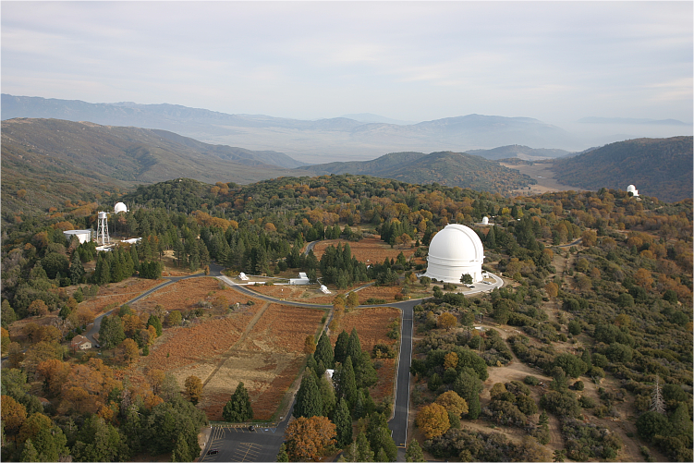
Zwicky Transient Facility: A phenomenological study of the transient Universe
P60
Classification (SEDM)
P48
Discovery
200-inch
Follow up
Notes:
But final action is at Keck (see next slide)

Slide 17
E. The beginnings

Slide 18
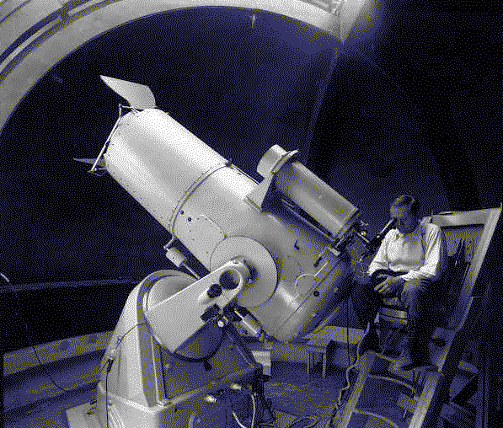
Time Domain Astronomy: Fritz Zwicky @ the Palomar 18-inch telescope
Notes:
Talk a bit about Zwicky. Milli Zwicky etc
Von Karman, father of modern aeronautics, Zwicky as unit of roughness

Slide 19
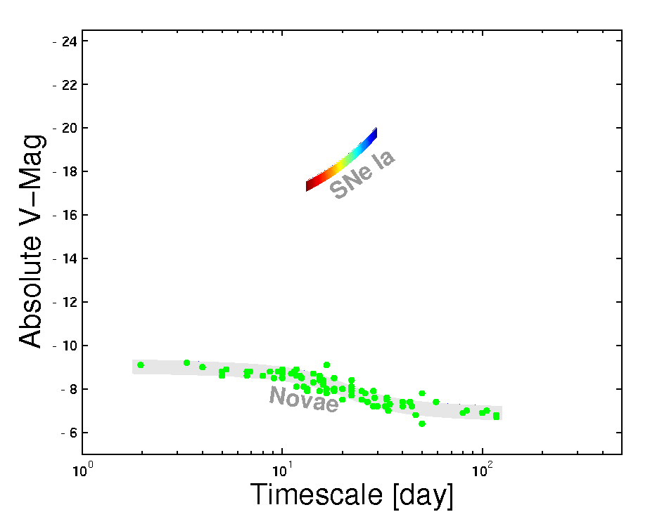
“Nova, Super-nova” & ”Phase Space”
Baade & Zwicky
Notes:
It wasn’t hardly centuries ago that mankind thought the universe was unchanging. The discovery of transients has now led us to believe that the universe changes not only on month and weeks but also days, hours and minutes!
In Ay 1, or any introduction to cosmic explosions, two classes of optical transients are introduced - novae and supernovae. our understanding about them has grown in leaps and bounds in the past two decades. And for good reason. They are both easy to find and Novae are faint but plentiful, supernovae are rare but bright. Since the time of Hubble, this curious gap has been noted, and we have asked, are there are hitherto an undiscovered class of transients? Let us quantify this gap next.

Slide 20
F. Steps leading To the Palomar transient Factory

Slide 21
Macronova Model
As a part of teaching Ay125 I re-investigated the mini-supernova model
I noted “mini x super=1” and so called the resulting event as “macronova”
Wrote the paper (Kulkarni 2005) during summer at MPA, Garching
Composition
  Free Neutrons
  Radioactive Nickel
  Neutron Rich Material (non-radioactive)
Injection of energy essential for macronova to shine and be detectable
Surprisingly detectable even with free neutron stars
  But would be short lived (few days)

Slide 22
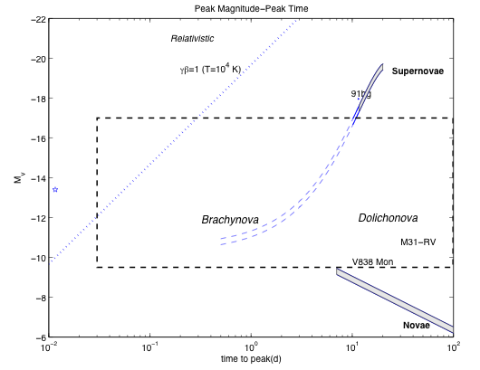
Phase space of explosions is likely very rich
Macronovae
Dolicho: long
Brachy: short
Kulkarni 2007

Slide 23
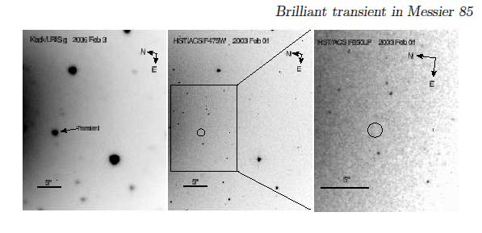
M85OT2006: harbinger
Kulkarni et al. 2007

Slide 24
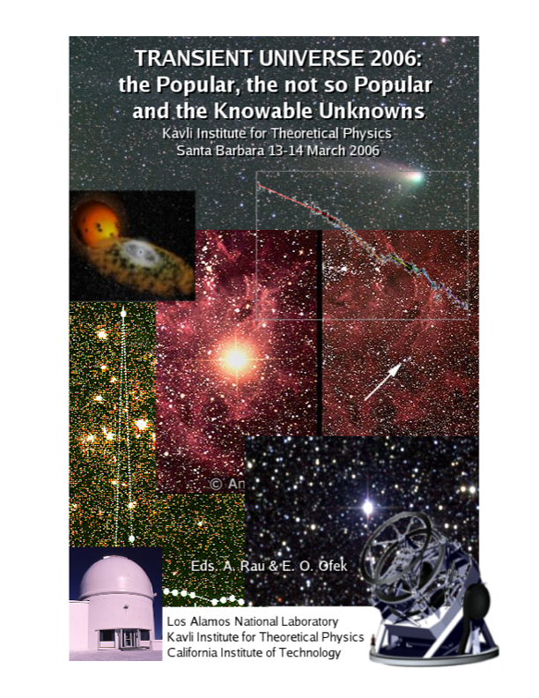

Slide 25
G. A Factory to make discoveries

Slide 26
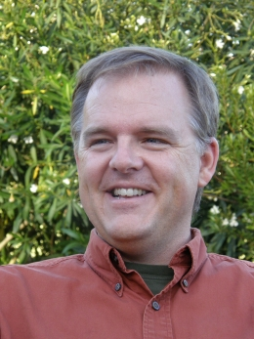

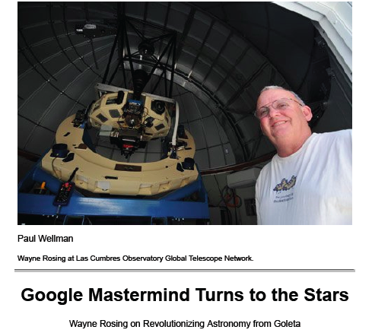
Notes:
Back to the idea of a factory

Slide 27
Palomar Transient Factory
P60
Confirmation
P48
Discovery
200-inch
Classification
Notes:
But final action is at Keck (see next slide)

Slide 28
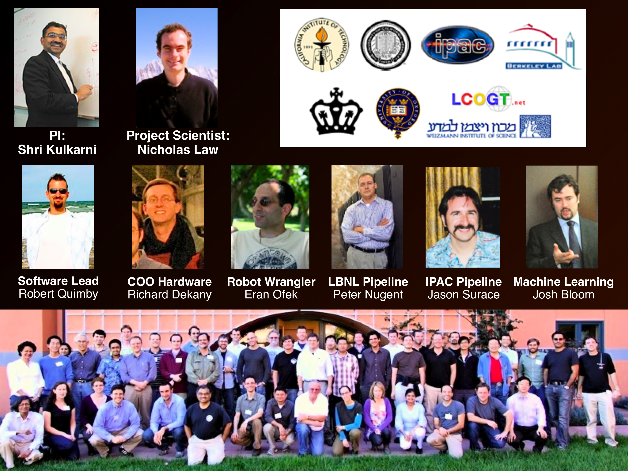
Palomar Transient Factory:
Hardware, Software & Grayware!

Slide 29
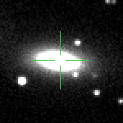
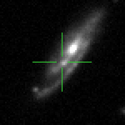
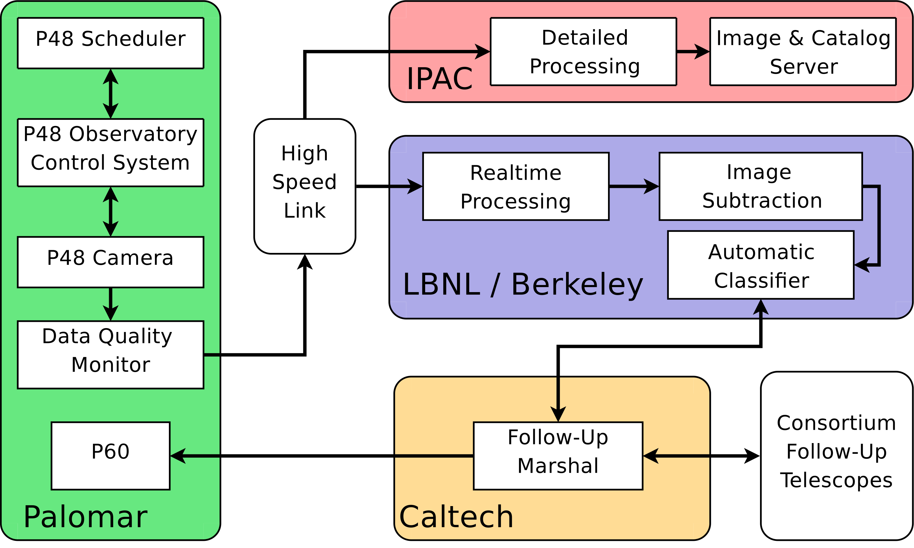
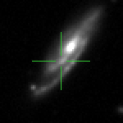
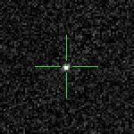
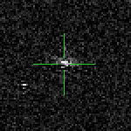
Software, software & more software
NEW
Rapid
REF
Time from exposure to candidates in the subtraction database: 20 - 40 minutes
SUB
Supernova, good!
Subtraction artifacts, bad!

Slide 30
Methodology & Technological Developments
Phase I (Palomar Transient Factory): 2009-2012
  Machine Learning for classification
  Same night classification & follow up
Phase II (intermediate Transient Factory): 2013-2016
  Mixed cadence observing
  Multi-band observing
  Robotic IFU spectroscopy (SEDM on P60)
  Demonstration of Needle in a haystack Search
Phase III (Zwicky Transient Factory): 2018-2020
  Pre-cursor to LSST for Time Domain Astronomy
  Industrialization of alert distribution

